Slide 1
Git induction
Source code management system
Free and open source
Implicit backup
Easier brancing

Slide 2
index
Local repository
Commits,pull,push,clone,tag
Creation Branches
Reslove conflicts
Apply stash
Frok a repository
Creating pull request
Merging pull request
.gitignore

Slide 3
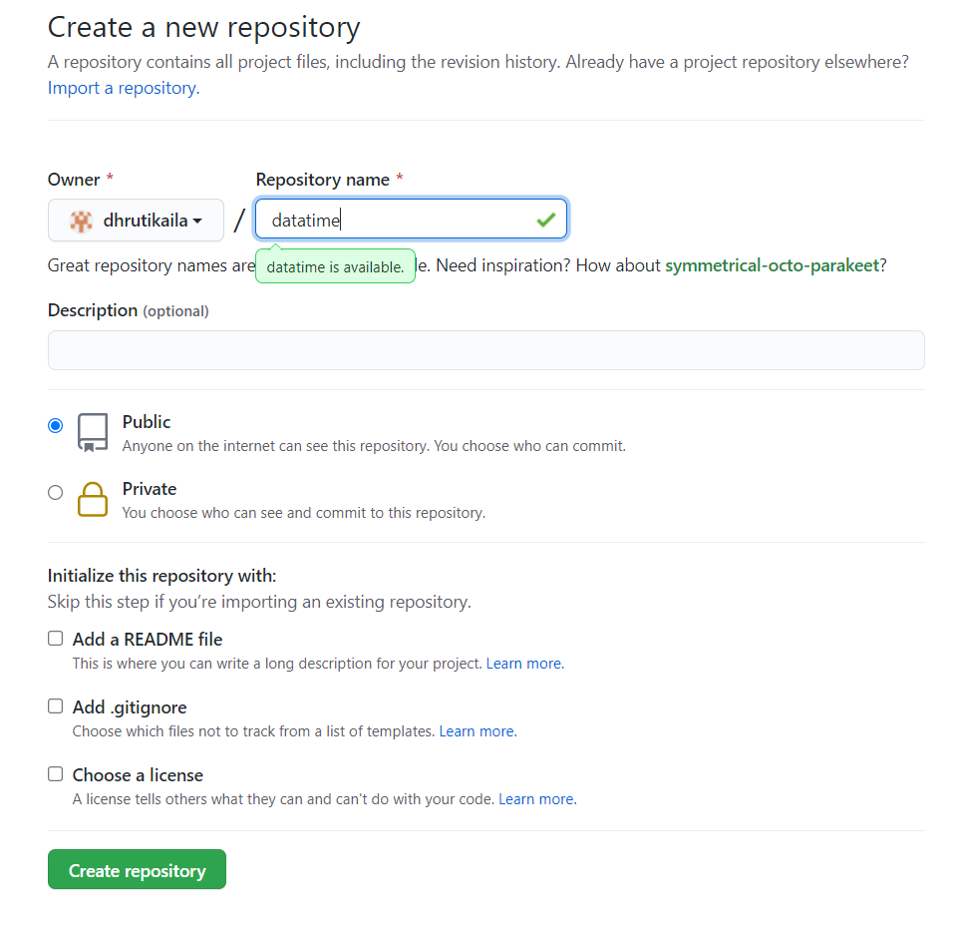
Create repository

Slide 4
Commits,pull,push,clone
Commits include lots of metadata in addition to the contents and message, like the author, timestamp, and more.
git pull updates your current local working branch, and all of the remote tracking branches. It's a good idea to run git pull regularly on the branches you are working on locally.
git push uploads all local branch commits to the corresponding remote branch.
The git clone command is used to create a copy of a specific repository or branch within a repository.Git is a distributed version control system. Maximize the advantages of a full repository on your own machine by cloning.

Slide 5
Create branch from git & checkout
After you have created a branch, you need to switch in this branch using a git checkout command.
Checkout use command git checkout “brancename which you have created”

Slide 6
Difference fetch & pull
git fetch is the command that tells your local git to retrieve the latest meta-data info from the original (yet doesn’t do any file transferring. It’s more like just checking to see if there are any changes available).
git pull on the other hand does that AND brings (copy) those changes from the remote repository.

Slide 7
Conflicts reslove
Git can handle most merges on its own with automatic merging features. A conflict arises when two separate branches have made edits to the same line in a file, or when a file has been deleted in one branch but edited in the other. Conflicts will most likely happen when working in a team environment.

Slide 8
Stage the changes
Before we make a commit, we must tell Git what files we want to commit (new untracked files, modified files, or deleted files). This is called staging and uses the add command.

Slide 9
stach
Use git stash when you want to record the current state of the working directory and the index, but want to go back to a clean working directory. The command saves your local modifications away and reverts the working directory to match the HEAD commit.

Slide 10
Fork repository
Most commonly, forks are used to either propose changes to someone else's project or to use someone else's project as a starting point for your own idea. You can fork a repository to create a copy of the repository and make changes without affecting the upstream repository.

Slide 11
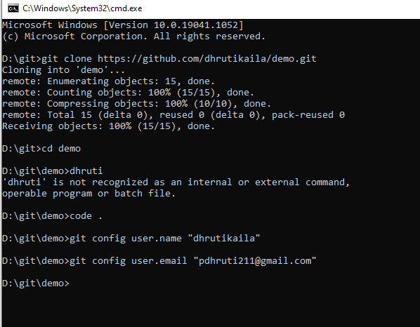
Clone

Slide 12
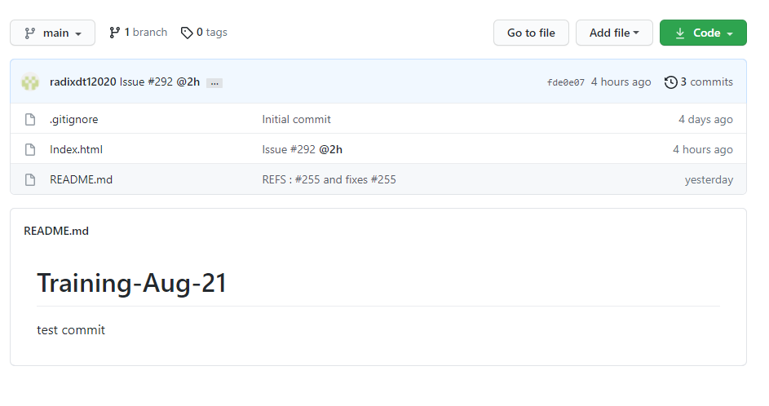
pull

Slide 13
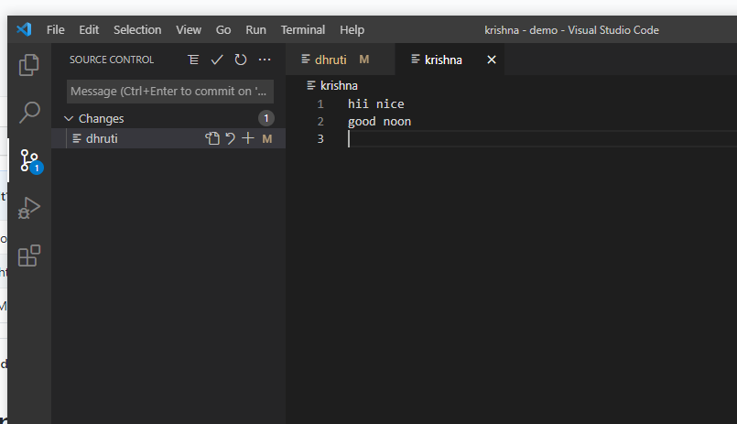
push

Slide 14
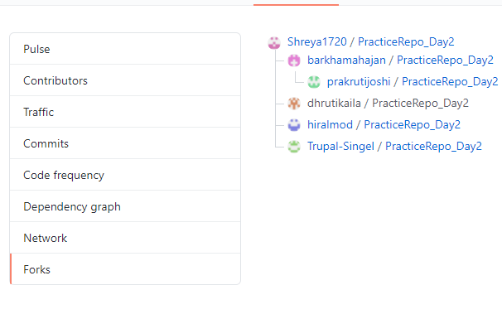
Fork the repository

